Slide 1
UE20CS971– Project Phase – 1
End Semester Assessment
Project Title : Simple Agentic AI workflow for AIOPS (Agentic AIOPS)
Project Guide : Dr. Milan Joshi
Surendar Raj
PES M.TECH DSML 2023 , PES2PGE23DS089

Slide 2
Agenda
Problem Statement
Abstract and Scope
Literature Survey
Suggestions from Review – 3
Design Approach
Design Constraints, Assumptions & Dependencies
Proposed Methodology / Approach
Architecture
Design Description
Technologies Used
Project Progress
References

Slide 3
Problem Statement
The growing complexity and scale of contemporary IT systems produce enormous amounts of high-velocity, heterogeneous telemetry data, such as events, logs, metrics, and traces.
Such complexity is beyond the capabilities of traditional rule-based monitoring techniques, which frequently result in poor root cause analysis and incident detection.
Even though modern AIOps platforms include some automation, they usually lack the inter-agent coordination, contextual awareness, and adaptive learning skills required for comprehensive operations management.

Slide 4
Abstract and Scope
With the use of autonomous, goal-driven agents, this work offers a streamlined Agentic AI process intended to improve AIOps. AIOps (Artificial Intelligence for IT Operations) denotes the use of AI and machine learning to automate and enhance IT operations, including anomaly detection, root cause analysis, and predictive maintenance. The operational system uses anomaly detection algorithms to find anomalies in operational data streams, including logs, metrics, and traces. Agents independently identify the underlying reasons and initiate corrective measures, such as resource scaling or service restarts, using reasoning and history correlation. The agents can improve the effectiveness of incident resolution by continuously refining their replies through a feedback loop. This agentic workflow provides a scalable basis for proactive and self-healing AIOps settings by combining intelligent policy engines, automation frameworks, and observability tools. Operational efficiency is increased, and human intervention is reduced in AIOPS by using AI agents to manage different tasks.

Slide 5
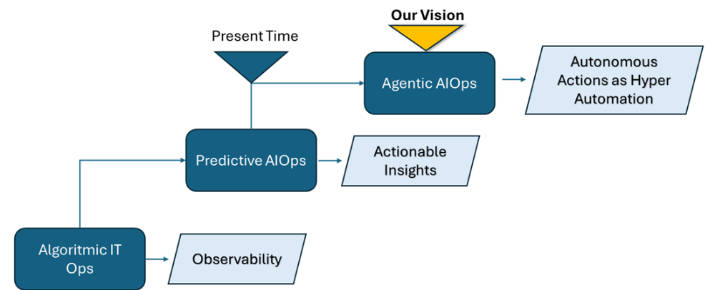
Literature Survey - A Practical Approach to Defining a Framework for Developing an Agentic AIOps
Răzvan Daniel Zota 1,* , Corneliu Bărbulescu 2 and Radu Constantinescu
Diagram illustrates the evolution from algorithmic IT operations to predictive AIOps(2017) and ultimately to Agentic AIOps, where autonomous agents drive hyper-automation.
https://doi.org/10.3390/electronics14091775

Slide 6
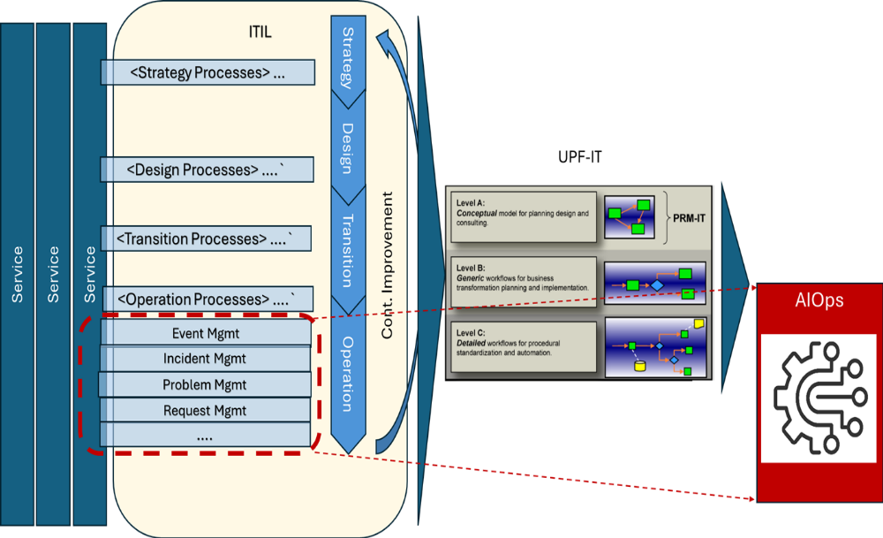
Literature Survey - A Practical Approach to Defining a Framework for Developing an Agentic AIOps
Răzvan Daniel Zota 1,* , Corneliu Bărbulescu 2 and Radu Constantinescu
UPF-IT: Unified Platform Framework for IT Operations
UPF-IT refers to a Unified Platform Framework designed to streamline, automate, and intelligently manage modern IT operations. It integrates key AIOps capabilities—such as observability, predictive analytics, and agent-based decision-making—into a cohesive architecture.
https://doi.org/10.3390/electronics14091775

Slide 7
Literature Survey - A Practical Approach to Defining a Framework for Developing an Agentic AIOps
Răzvan Daniel Zota 1,* , Corneliu Bărbulescu 2 and Radu Constantinescu
140 relevant articles, filtered based on recency, relevance, and credibility. This resulted in a final selection of 42 high-impact studies containing key themes such as the following:
Anomaly detection,
Event correlation,
Automated remediation,
Intelligent decision-making in AIOps workflows.
https://doi.org/10.3390/electronics14091775

Slide 8
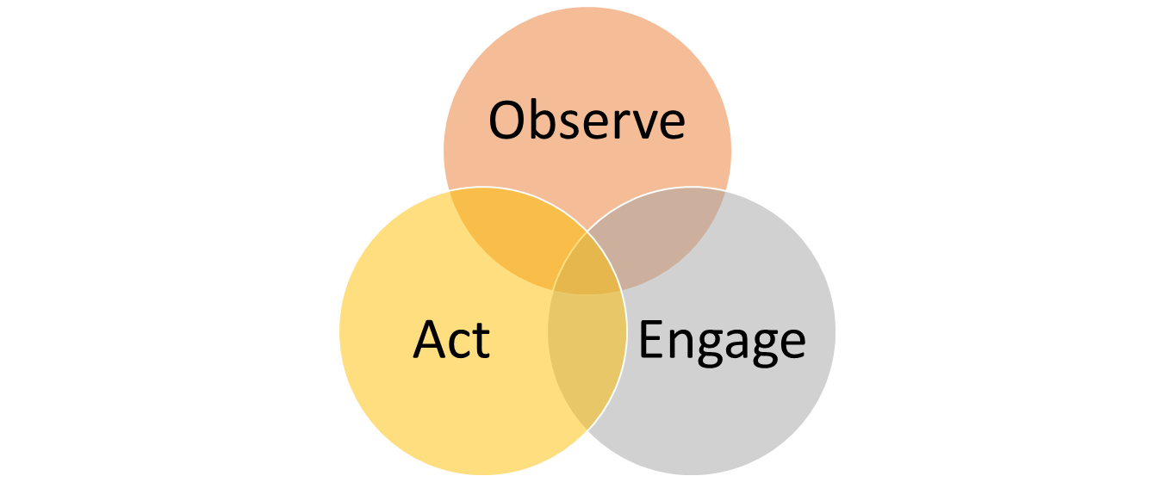

Literature Survey - Hands-on AIOps: Best Practices Guide to Implementing AIOps
Navin Sabharwal, Gaurav Bhardwaj
Three key Areas of in IT Operations
Anomaly Detection
Self healing Scripts
https://books.google.co.in/books?id=HqsizwEACAAJ

Slide 9
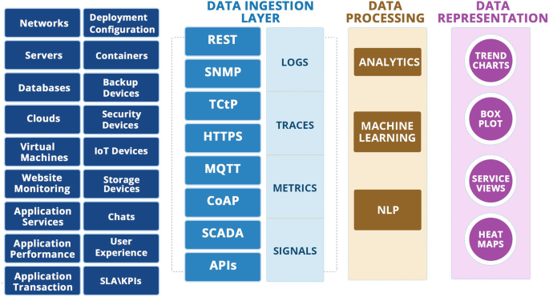
Literature Survey - Hands-on AIOps: Best Practices Guide to Implementing AIOps
Navin Sabharwal, Gaurav Bhardwaj
AIOPS Layers
https://books.google.co.in/books?id=HqsizwEACAAJ

Slide 10
Literature Survey - Hands-on AIOps: Best Practices Guide to Implementing AIOps
Navin Sabharwal, Gaurav Bhardwaj
AIOPS Major Cases
Deduplication
Automated Baselining
Anomaly Detection
Remediation
https://books.google.co.in/books?id=HqsizwEACAAJ

Slide 11
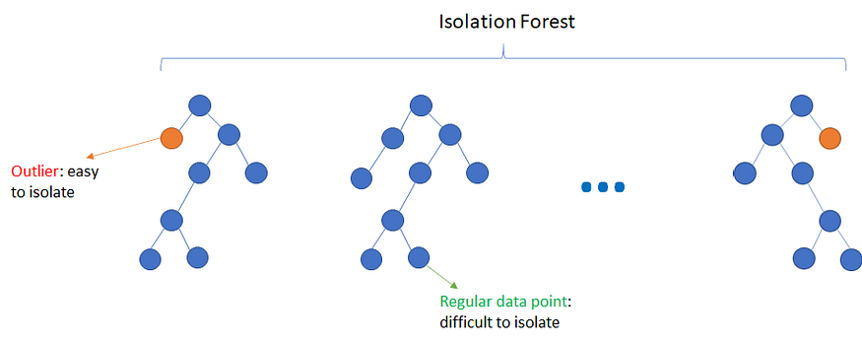
Literature Survey - Hands-on AIOps: Best Practices Guide to Implementing AIOps
Navin Sabharwal, Gaurav Bhardwaj
Anomaly Detection
Automated identification of unusual patterns in IT Systems (high CPU, disk full etc.)
Isolation Forest - unsupervised machine learning algorithm specifically designed to detect rare events (also called outliers)
https://books.google.co.in/books?id=HqsizwEACAAJ

Slide 12
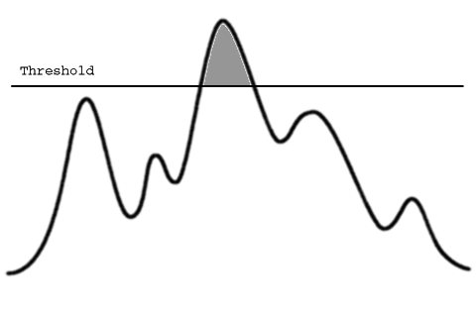
Literature Survey - Hands-on AIOps: Best Practices Guide to Implementing AIOps
Navin Sabharwal, Gaurav Bhardwaj
Automated Baselining
Automated baselining is the process of Adapting to seasonality & trends.
Useful as over time — without manual thresholds — adjust values as per season and detect deviations (anomalies)
Learns patterns automatically.
ARIMA model for forecast and setting thresholds
https://books.google.co.in/books?id=HqsizwEACAAJ

Slide 13
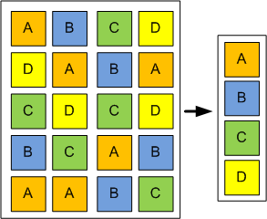
Literature Survey - Hands-on AIOps: Best Practices Guide to Implementing AIOps
Navin Sabharwal, Gaurav Bhardwaj
Automated Deduplication
Identifying and suppressing duplicate alerts or events that describe the same underlying issue.
Single root cause ticket
https://books.google.co.in/books?id=HqsizwEACAAJ

Slide 14
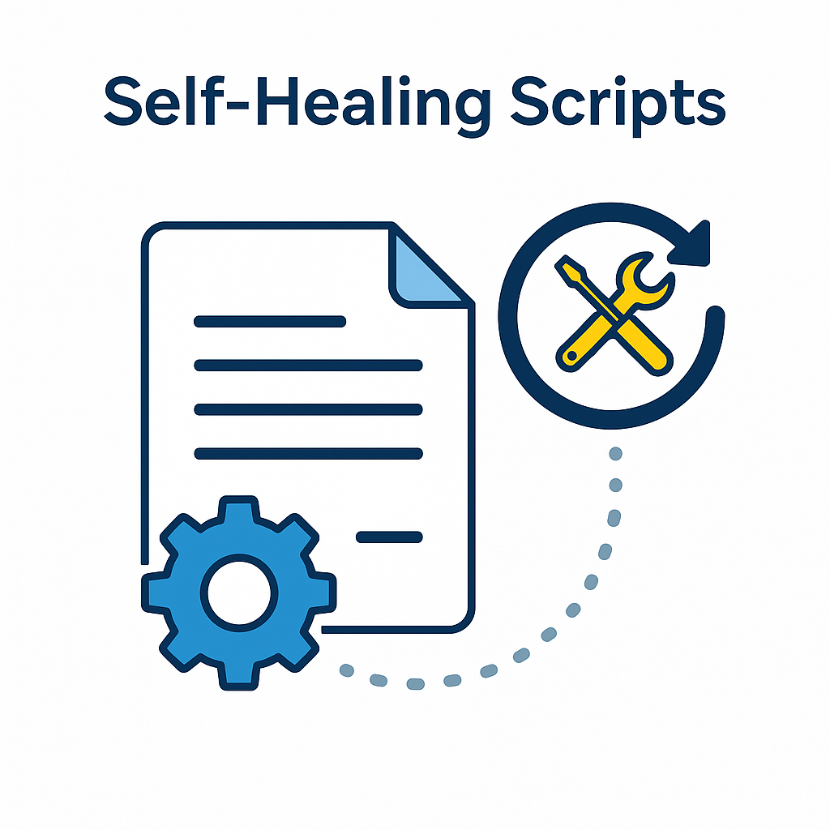
Literature Survey - Hands-on AIOps: Best Practices Guide to Implementing AIOps
Navin Sabharwal, Gaurav Bhardwaj
Automated Remediation
automatic resolution of IT incidents, anomalies, or alerts — triggered after detection and analysis
https://books.google.co.in/books?id=HqsizwEACAAJ

Slide 15
Literature Survey - AIOpsLab: A Holistic Framework to Evaluate AI Agents for Enabling Autonomous Clouds
Yinfang Chen, Manish Shetty, Gagan Somashekar, Minghua Ma, Yogesh Simmhan, Jonathan Mace, Chetan Bansal, Rujia Wang, Saravan Rajmohan
A framework designed to evaluate AI agents for autonomous cloud operations. It supports end-to-end lifecycle management by enabling agents to detect, localize, diagnose, and mitigate faults in microservice environments.
cloud-agent orchestrator, fault and workload generators, a telemetry system, and a unified Agent-Cloud Interface (ACI)
Paper loosely uses term AgentOps as Agent for operations ××.
But AgentOps is a emerging discipline focused on the end-to-end lifecycle management of AI agents
https://doi.org/10.48550/arXiv.2501.06706

Slide 16
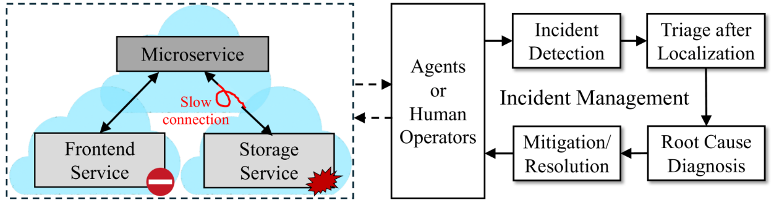
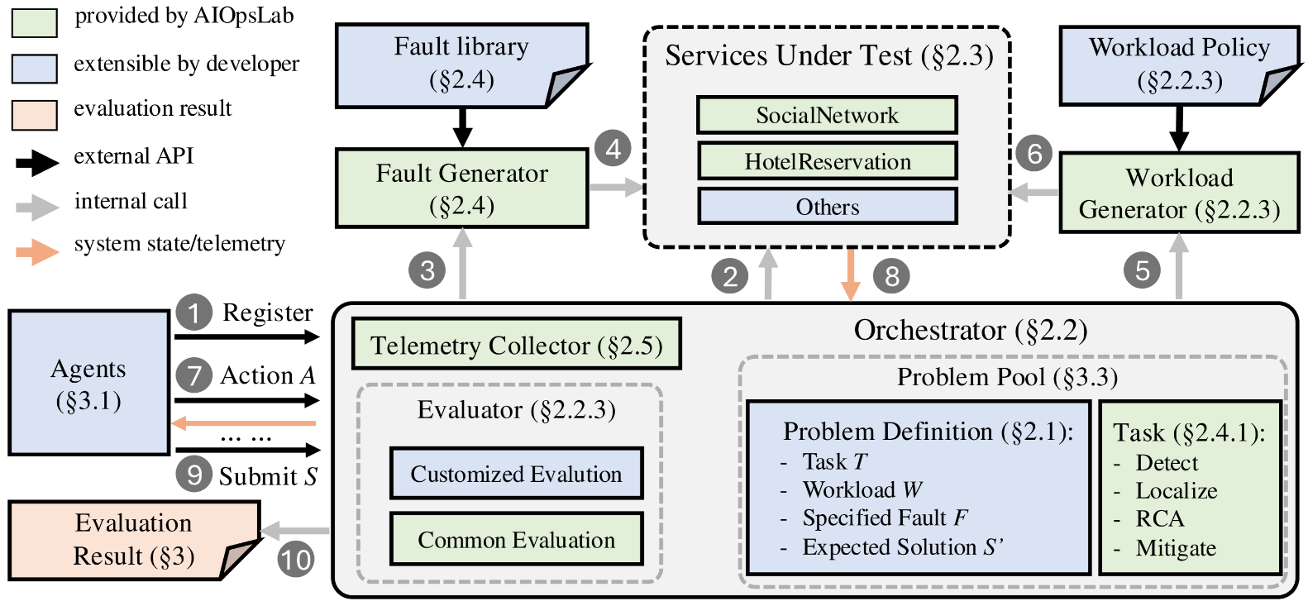
Literature Survey - AIOpsLab: A Holistic Framework to Evaluate AI Agents for Enabling Autonomous Clouds
Yinfang Chen, Manish Shetty, Gagan Somashekar, Minghua Ma, Yogesh Simmhan, Jonathan Mace, Chetan Bansal, Rujia Wang, Saravan Rajmohan
SYMPTOMATIC FAULTS and FUNCTIONAL FAULTS
https://doi.org/10.48550/arXiv.2501.06706

Slide 17
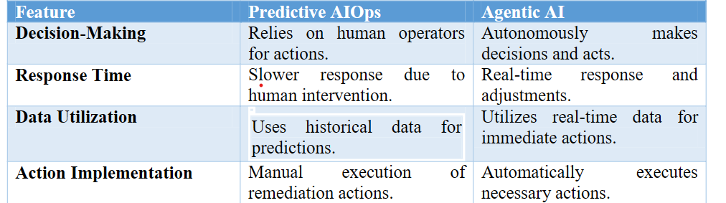
Literature Survey - Agentic AI in Predictive AIOps: Enhancing IT Autonomy and Performance
Shanmugasundaram Sivakumar
This paper talks about the advantages of using Agents over traditional predictive analytics.
https://doi.org/10.18535/ijsrm/v12i11.ec01

Slide 18
Suggestions from Review - 3
Suggestions and remarks
Consider Isolation Forrest rather than k-mean algorithm better suited for anomaly detection.
Explore and use multi-agents rather than single agent.
Compare LLM models and chose the best model
Explore Reporting

Slide 19
Design Details
Multi-Agent System (MAS) serves as design baseline for Agentic AIOps, LangGraph based builder serves as the workflow orchestration layer.
It allows you to define agent interaction logic, state transitions, and memory management in a flexible and composable way.
Agent 1: Detects anomalies
Agent 2: Deduplicates alerts
Agent 3: automated baselining
Agent 4: remediation, Triggers an action

Slide 20
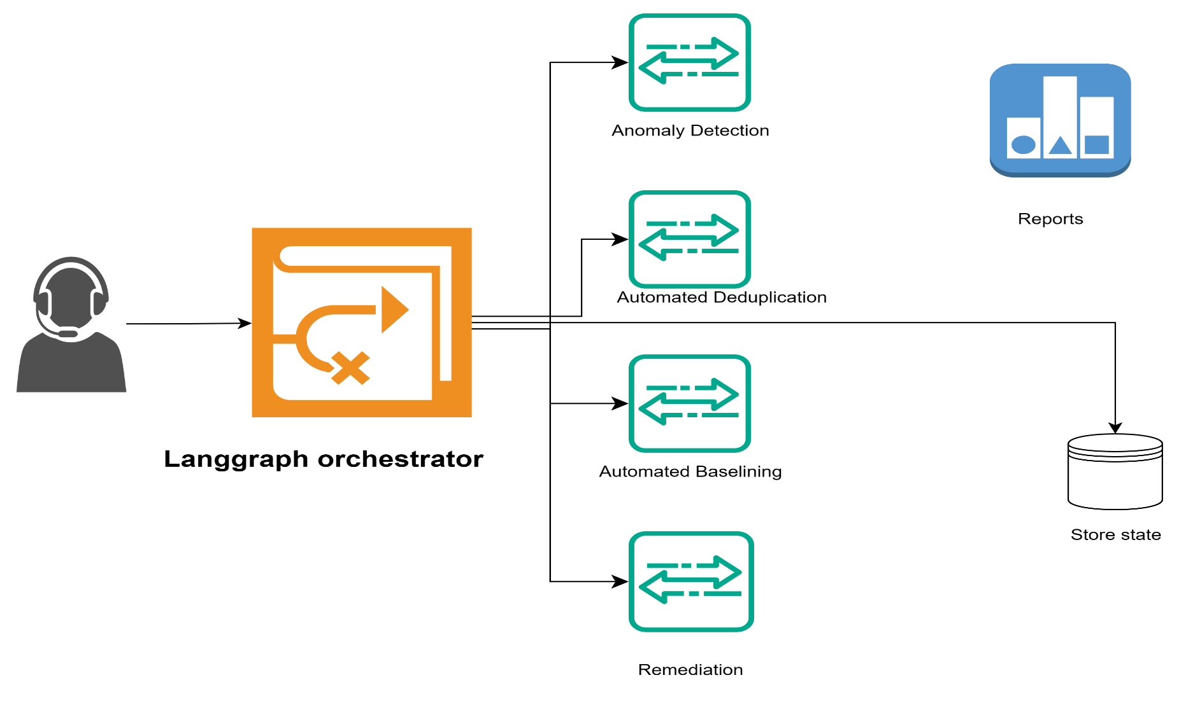
Design Details

Slide 21
Design Details
LangGraph orchestrates long-running, stateful AI agents using graph-based workflows.
Nodes – Functions or LangChain runnables (LLM agents/tools).
Edges – Define flow, conditionals, loops, and transitions.
StateGraph – Defines the graph structure and shared state object.

Slide 22
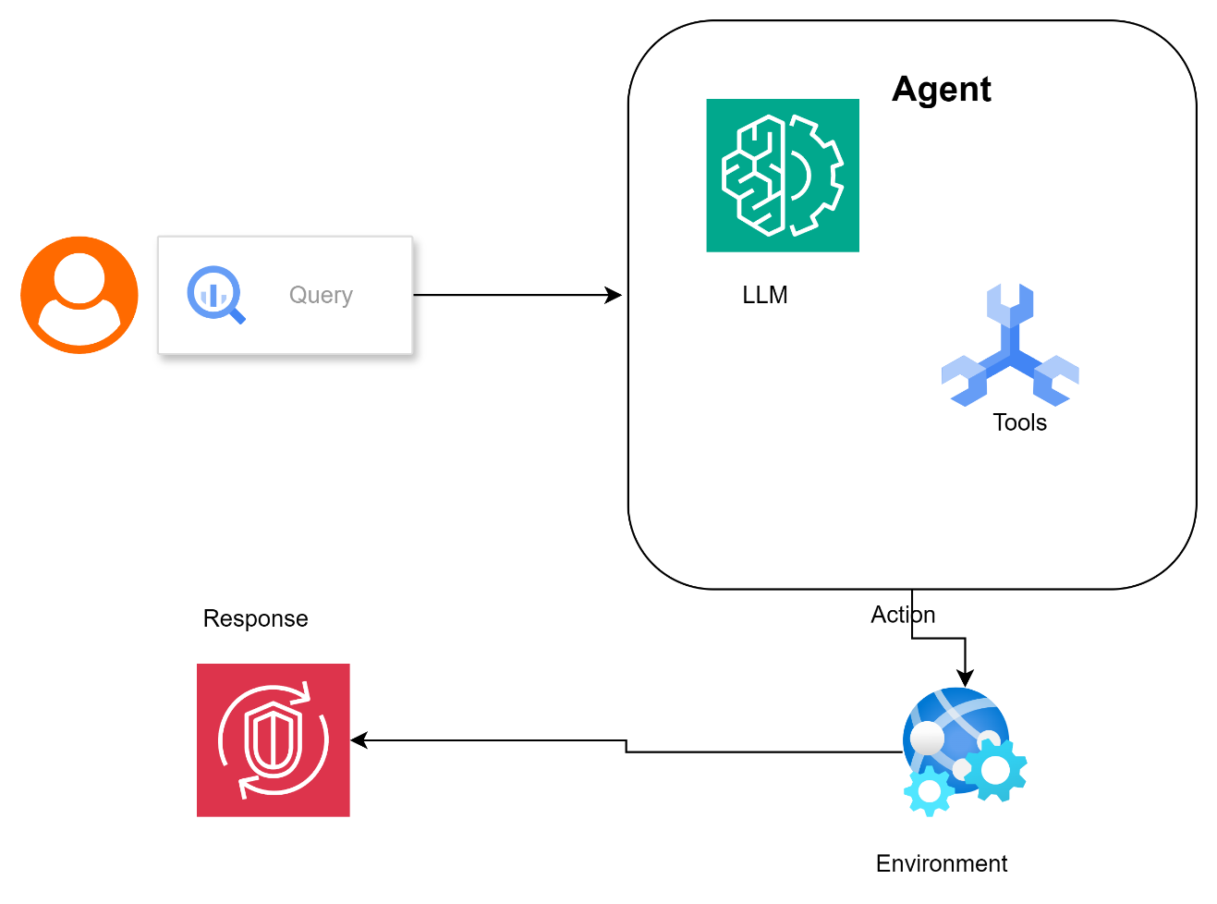
Design Details
Langchain is used to create Agents. Anomaly Detection uses ReAct(Reasoning and Act) Agent Design Pattern.

Slide 23
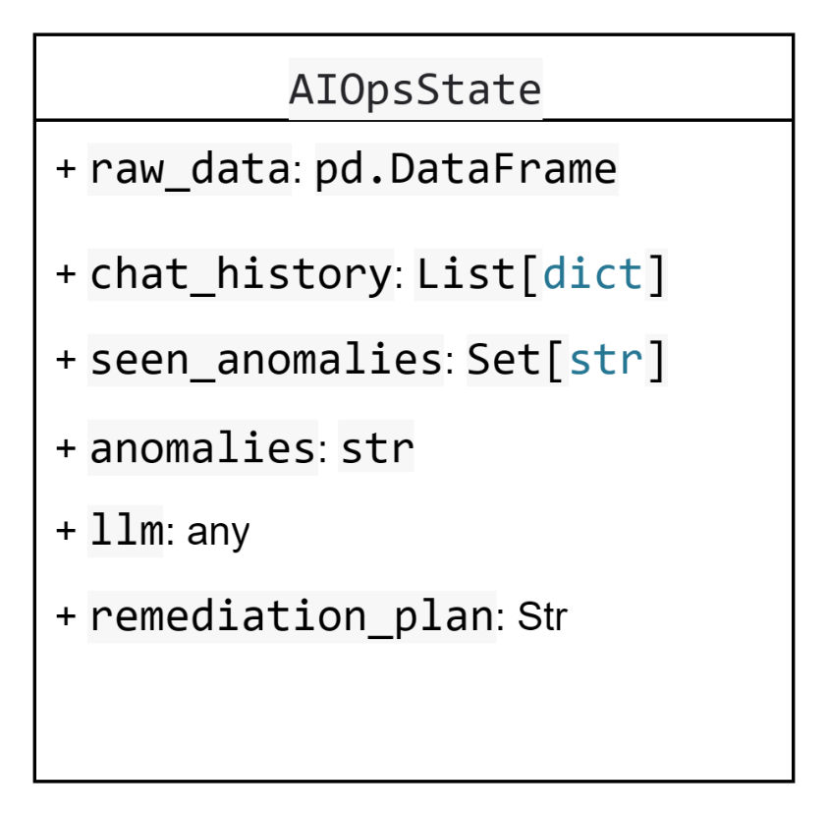
Design Description
Memory across all agents is managed by state Persistence
Following class is declared and shared across all agents.

Slide 24
Proposed Methodology / Approach
1. Data Preprocessing and Feature Extraction
Alerts are loaded from log files(alerts.csv) and cleaned by mapping alert sources (CPU, memory, disk).
2. Automated Baselining with ARIMA - Agent
A time-series forecast is constructed per metric (CPU, memory) using the ARIMA model.
3. Anomaly Detection with Isolation Forest-Agent
anomaly detection step uses Isolation Forest on telemetry data. An LLM (gpt 3.5-turbo via LangChain) processes the anomaly details.
4. Event Deduplication
Unique alert IDs from host, description, and timestamp
5. Workflow Orchestration with LangGraph
entire pipeline is modeled using LangGraph, Agent memory (chat history, seen anomalies) is preserved across runs.

Slide 25
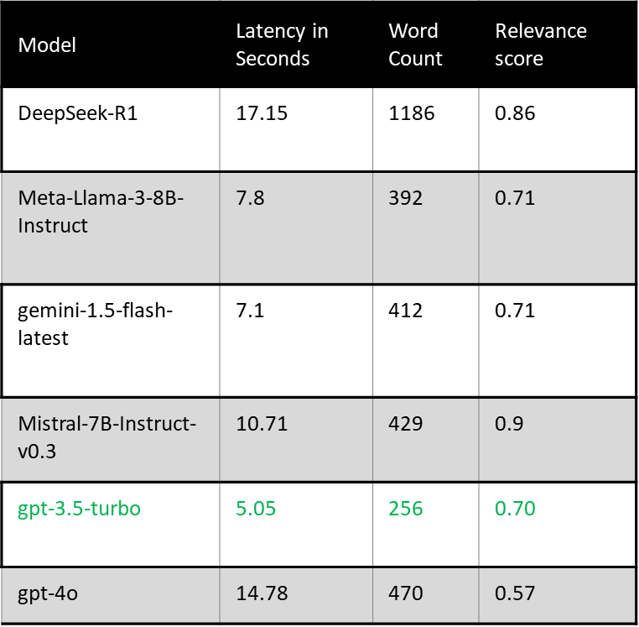
Proposed Methodology / Approach- experimentation
LLM comparison.
gpt-3.5-turbo offered the lowest latency with minimal word count, highlighting a trade-off between relevance score, speed, and cost across models.

Slide 26
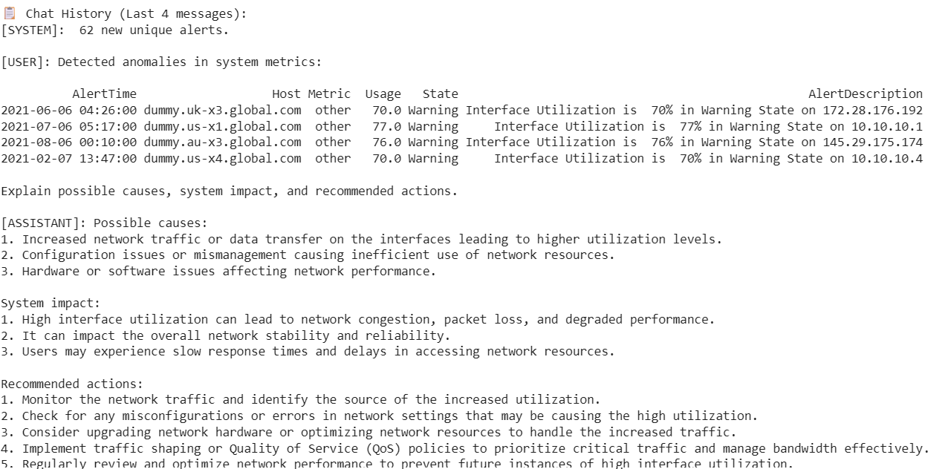
Proposed Methodology / Approach- Results

Slide 27
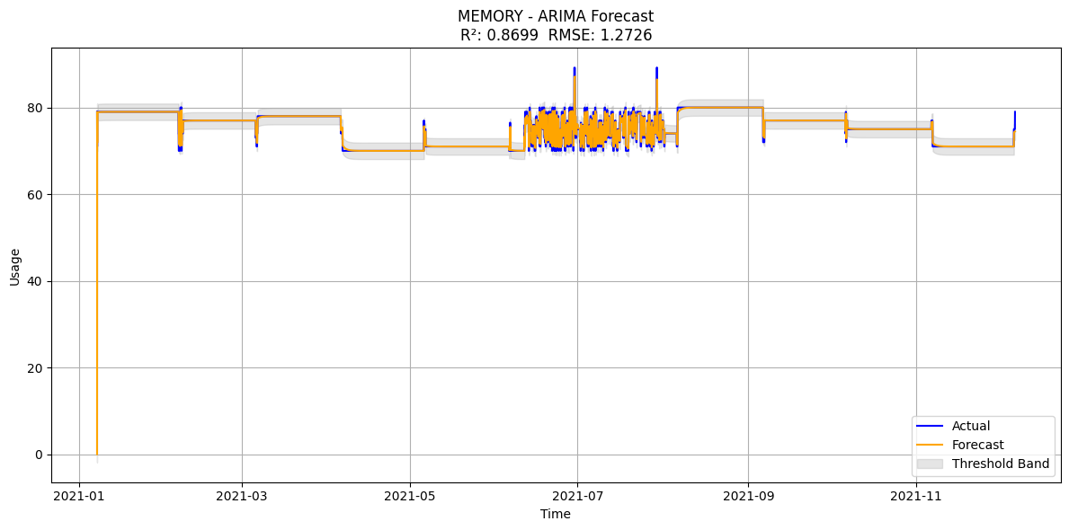
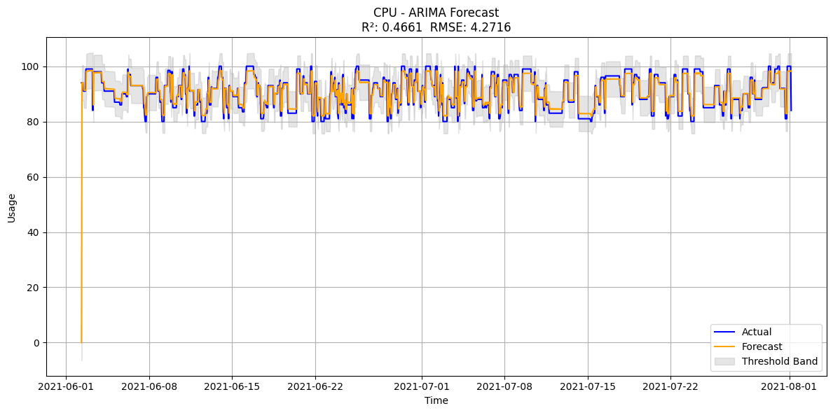
Proposed Methodology / Approach- Results
({'source': 'MEMORY', 'r2': 0.869871121398047, 'rmse': np.float64(1.272598593543709)}, {'source': 'CPU', 'r2': 0.46607870340768875, 'rmse': np.float64(4.27156936851952)})

Slide 28
Technologies Used
LangChain
LangGraph
Sklearn.ensemble Isolation Forest
Pandas
NumPy
matplotlib
And LLM was GPT 3.5-turbo.Reason for selection of this model was based on experimentation as discussed in methodology.

Slide 29
Project Progress
What is the project progress so far?
Progress has been without any technical hurdle.
What is the percentage completion of the project?
About 70% done. remediation with yaml and cloud technology being explored.

Slide 30
References
AIOpsLab: A Holistic Framework to Evaluate AI Agents for Enabling Autonomous Clouds ,
Yinfang Chen and Manish Shetty and Gagan Somashekar and Minghua Ma and Yogesh Simmhan and Jonathan Mace
and Chetan Bansal and Rujia Wang and Saravan Rajmohan, https://arxiv.org/abs/2501.06706
Hands-On AIOPS book, Navin Sabharwal , Gaurav Bhardwaj https://link.springer.com/book/10.1007/978-1-4842-8267-0
Jeroen Mulder, Enterprise DevOps for Architects: Leverage AIOps and DevSecOps for secure digital transformation , Packt Publishing, 2021.
Jieming Zhu, Shilin He, Pinjia He, Jinyang Liu, Michael R. Lyu. Loghub: A Large Collection of System Log Datasets for AI-driven Log Analytics. IEEE International Symposium on Software Reliability Engineering (ISSRE), 2023.
Zota, R. D., Bărbulescu, C., & Constantinescu, R. (2025). A Practical Approach to Defining a Framework for Developing an Agentic AIOps System. Electronics, 14(9), 1775. https://doi.org/10.3390/electronics14091775
Sivakumar, Shanmugasundaram. (2024). Agentic AI in Predictive AIOps Enhancing IT Autonomy and Performance. International Journal of Scientific Research and Management (IJSRM). 12. 1631-1638. 10.18535/ijsrm/v12i11.ec01. https://www.researchgate.net/publication/386575975_Agentic_AI_in_Predictive_AIOps_Enhancing_IT_Autonomy_and_Performance

Slide 31
Any other information
Provide any other information you wish to add on.
None until now
Note: Changes can be made in the template, with the consent of the guide for inclusion of any other information.

Slide 32
Thank You

